Slide 1
How Does a Bike-Share Navigate Speedy Success?
University of Waterloo
April 2023

Slide 2
Goal:
Solution:
Increase more company’s profit
maximizing the number of annual members by converting casual riders into annual members

Slide 3
Analytical goals
HOW: Identify annual members and casual riders use Cyclistic bikes differently

Slide 4
Analytical goals
HOW: Identify casual riders use Cyclistic bikes

Slide 5
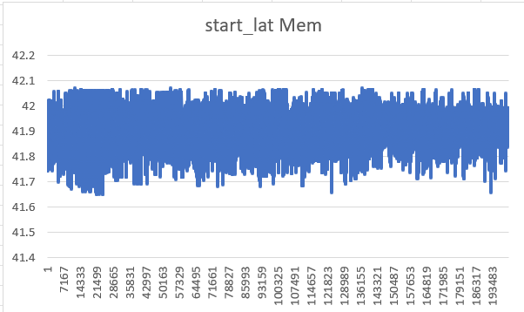
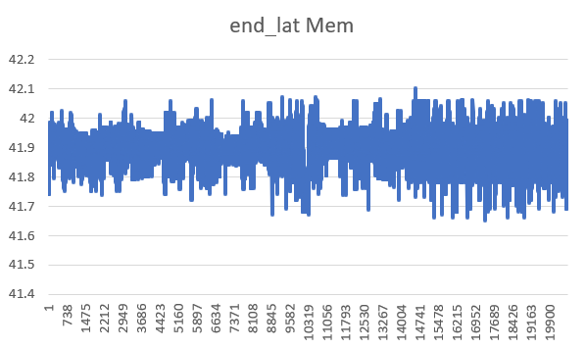
Significant fluctuations
Members use Cyclic bikes to travel along the latitude substantially.

Slide 6
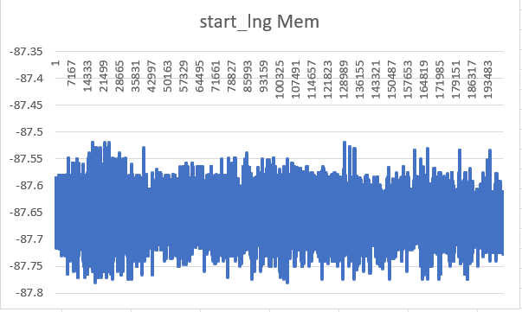
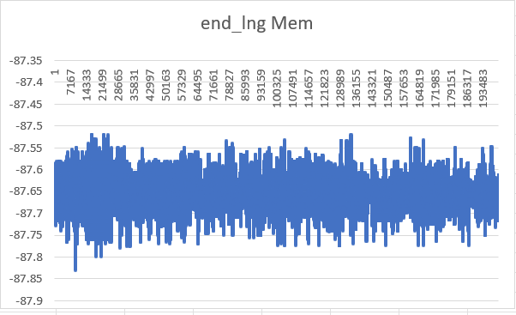
Smaller range fluctuations
Members use Cyclic bikes to travel along the longitude less substantially than latitude.

Slide 7
Now, we need to check how casual people use Cyclic bike different from members.

Slide 8
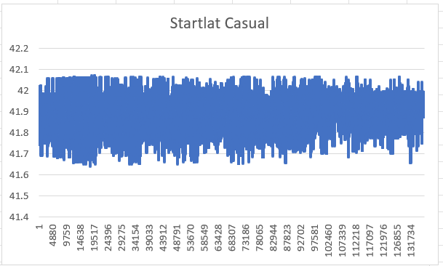
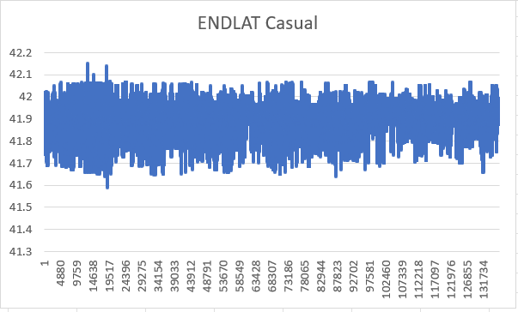
Small range of fluctuations
Casual people do not use Cyclic bikes to travel along the latitude very often

Slide 9
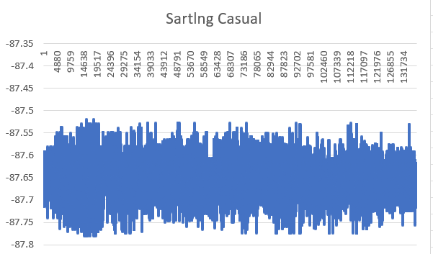
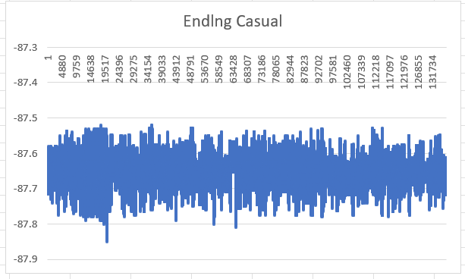
Large range of fluctuations
Casual people use Cyclic bikes to travel along the longitude in larger range than latitude.

Slide 10
Cyclic members and casual people using Cyclic bikes differently from the graphs above.

Slide 11
In Summary
HOW: Annual members prefer using Cyclic bikes to travel along the latitude, while casual people prefer travel along the longitude.

Slide 12
Further Exploration for Cyclic bikes use
Why would casual riders buy Cyclistic annual memberships?
How can Cyclistic use digital media to influence casual riders to become members?

Slide 13
Thank You.

